Slide 1
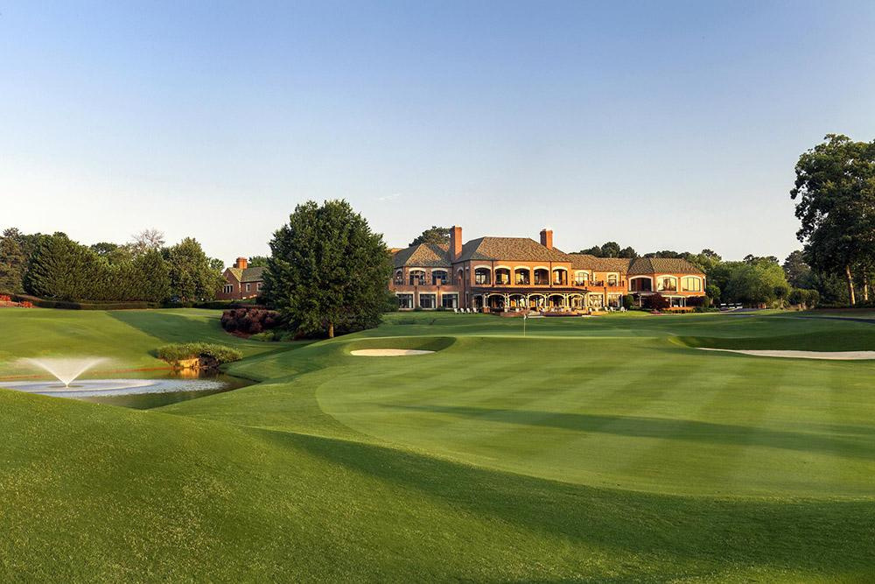

12TH ANNUAL
WARRICK DUNN CHARITIES
CELEBRITY GOLF CLASSIC
12th ANNUAL
SPONSORSHIP AND TICKET OPPORTUNITIES
Dunwoody Country Club
1600 Dunwoody Club Dr, Atlanta, GA 30350

Slide 2
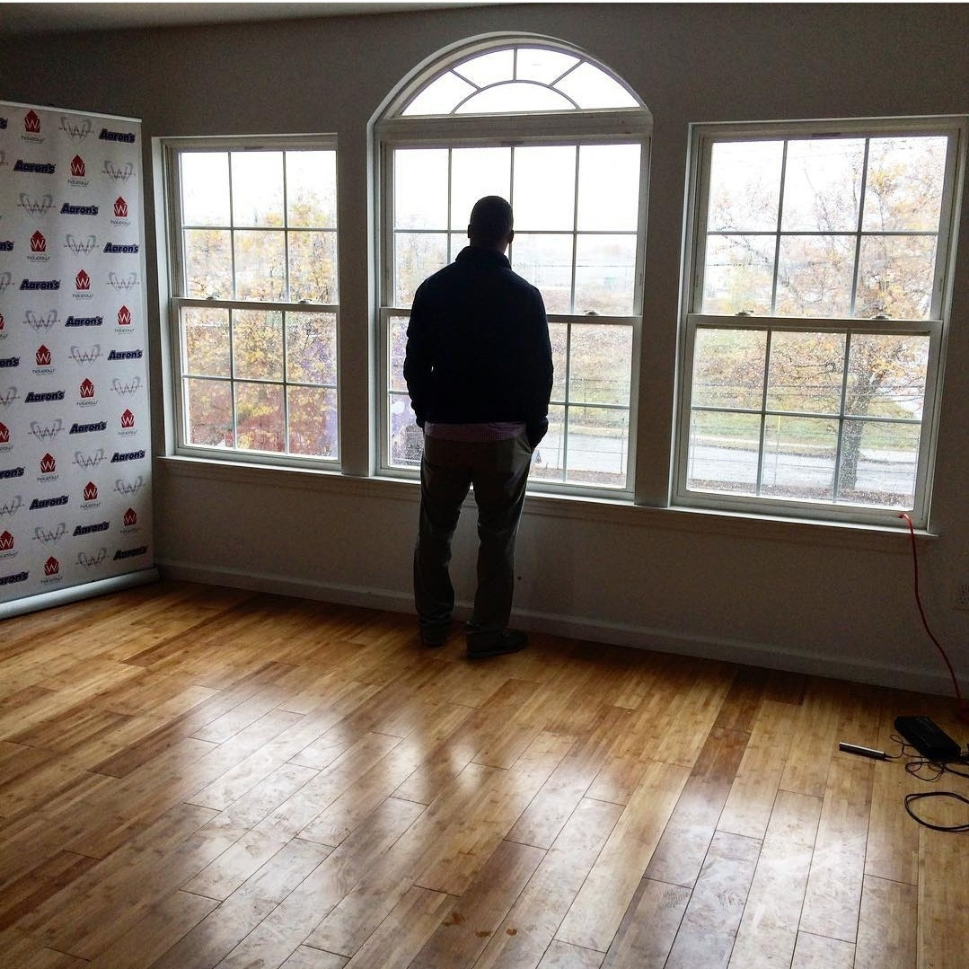
OUR STORY
As a rookie for Tampa Bay, Warrick founded our Homes for the Holidays program to fulfill his mother’s dream of home ownership for single parent families. The program partners with local organizations to turn houses into homes for single parent families through home furnishings and down-payment assistance. Since its inception, Homes for the Holidays has furnished 223 homes, provided over $1,090,000 in down-payment assistance, and served over 586 dependents.
The impact of Homes for the Holidays inspired Warrick to expand into three additional programs: Count on Your Future, Sculpt, and Hearts for Community Service Scholarships, all housed today under the Warrick Dunn Charities umbrella. Together, the four programs are dedicated to strengthening and transforming communities by combating poverty, hunger, and improving the quality of lives for families academically, socially, and economically.

Slide 3
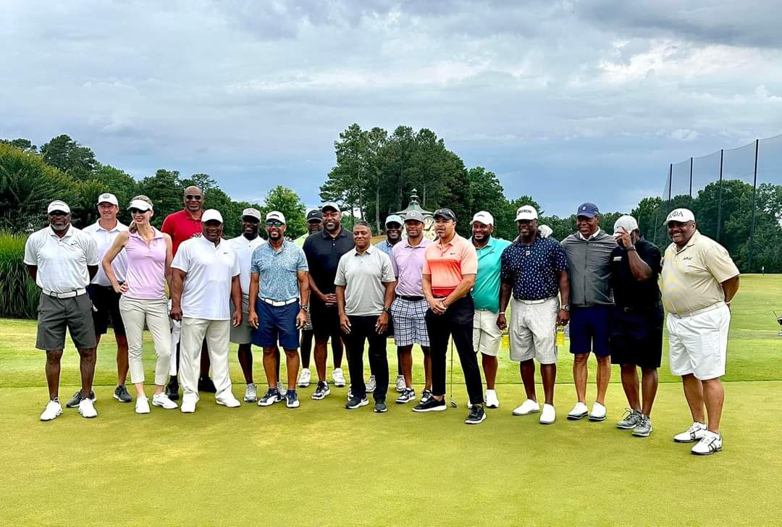
TOUCHDOWN SPONSOR - $30,000
• 3 Teams at Celebrity Golf Classic including celebrity golfers, appreciation gifts, golf polos
• 15 Tickets to Exclusive Pairings Party Sunday prior to the golf event
• Logo in print on top panel and digitally on PGA Style Electronic display board in all team photos
• Verbal Recognition and opportunity to speak at pairings party Sunday evening in Atlanta and at Shotgun start at Golf Classic
• First Pick of Celebrity Golfers for Teams
• Opportunity for branded item placement in gift bag for Celebrity Golf Classic
• Logo and brand recognition in select print materials and social media
• Hole signs on course with logo

Slide 4
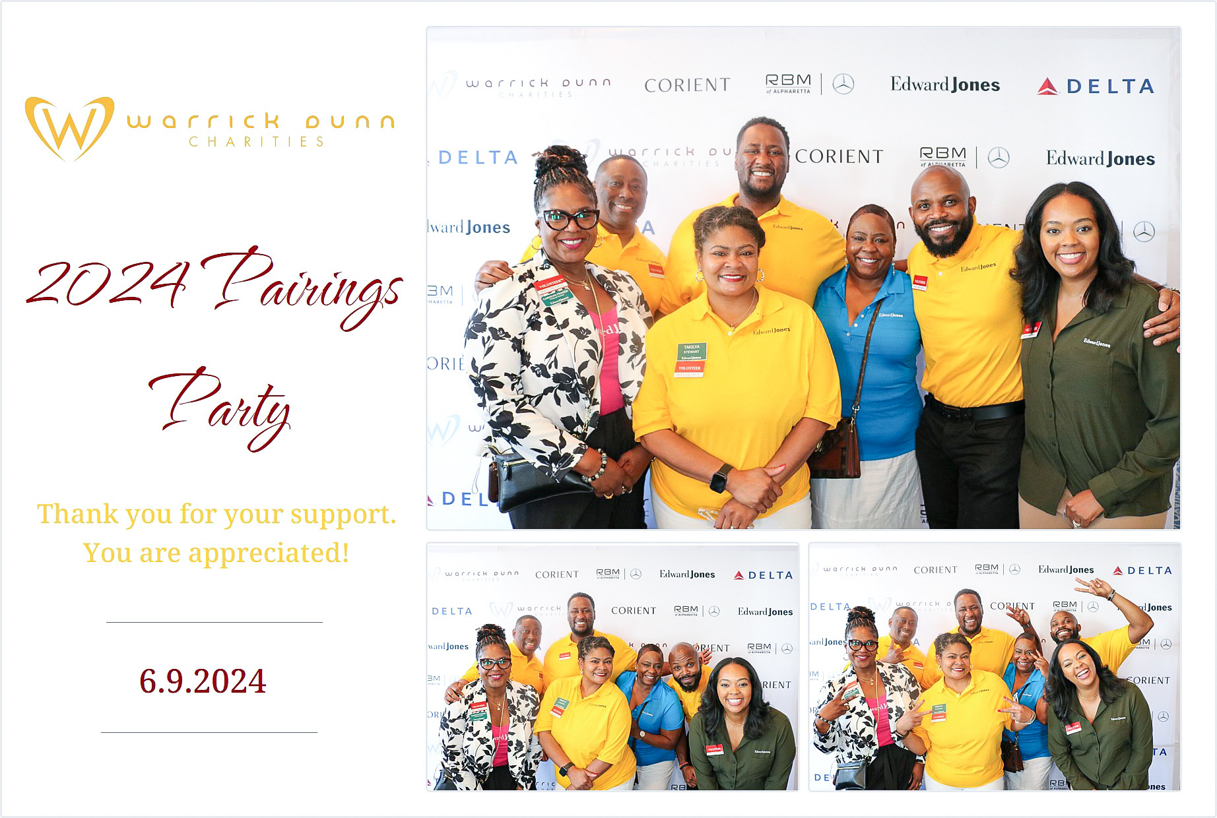
PAIRINGS PARTY SPONSOR - $20,000
• 2 Teams at Celebrity Golf Classic including celebrity golfers, appreciation gifts, golf polos
• 10 Tickets to Exclusive Pairings Party Sunday prior to the golf event
• Logo on signage at Pairings Party Sunday prior to the golf event
• Logo in pr int on first position of side panel and digitally on PGA Style Electronic display board in all team photos
• Verbal Recognition at Shotgun Start
• Company remarks during After play Reception
• Second Pick of Celebrity Golfers for Teams
• Opportunity for branded item placement in gift bag for Celebrity Golf Classic
• Logo and brand recognition in select print materials and social media

Slide 5
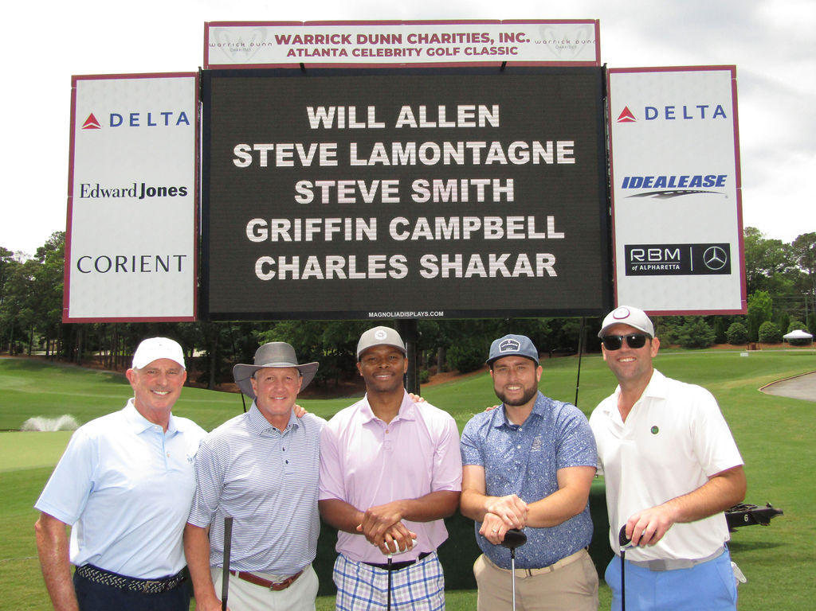
FIELD GOAL SPONSOR - $15,000
• 1 Team at Celebrity Golf Classic including celebrity golfers, appreciation gifts, golf polos
• 10 Tickets to Exclusive Pairings Party Sunday prior to the golf event
• Logo in pr int on first position of side panel and digitally on PGA Style Electronic display board in all team photos
• Verbal Recognition at Shotgun Start
• Company remarks during After play Reception
• Second Pick of Celebrity Golfers for Teams
• Logo on golf pin flag
• Logo on gift item for players
• Opportunity for branded item placement in gift bag for Celebrity Golf Classic
• Logo and brand recognition in select print materials and social media

Slide 6
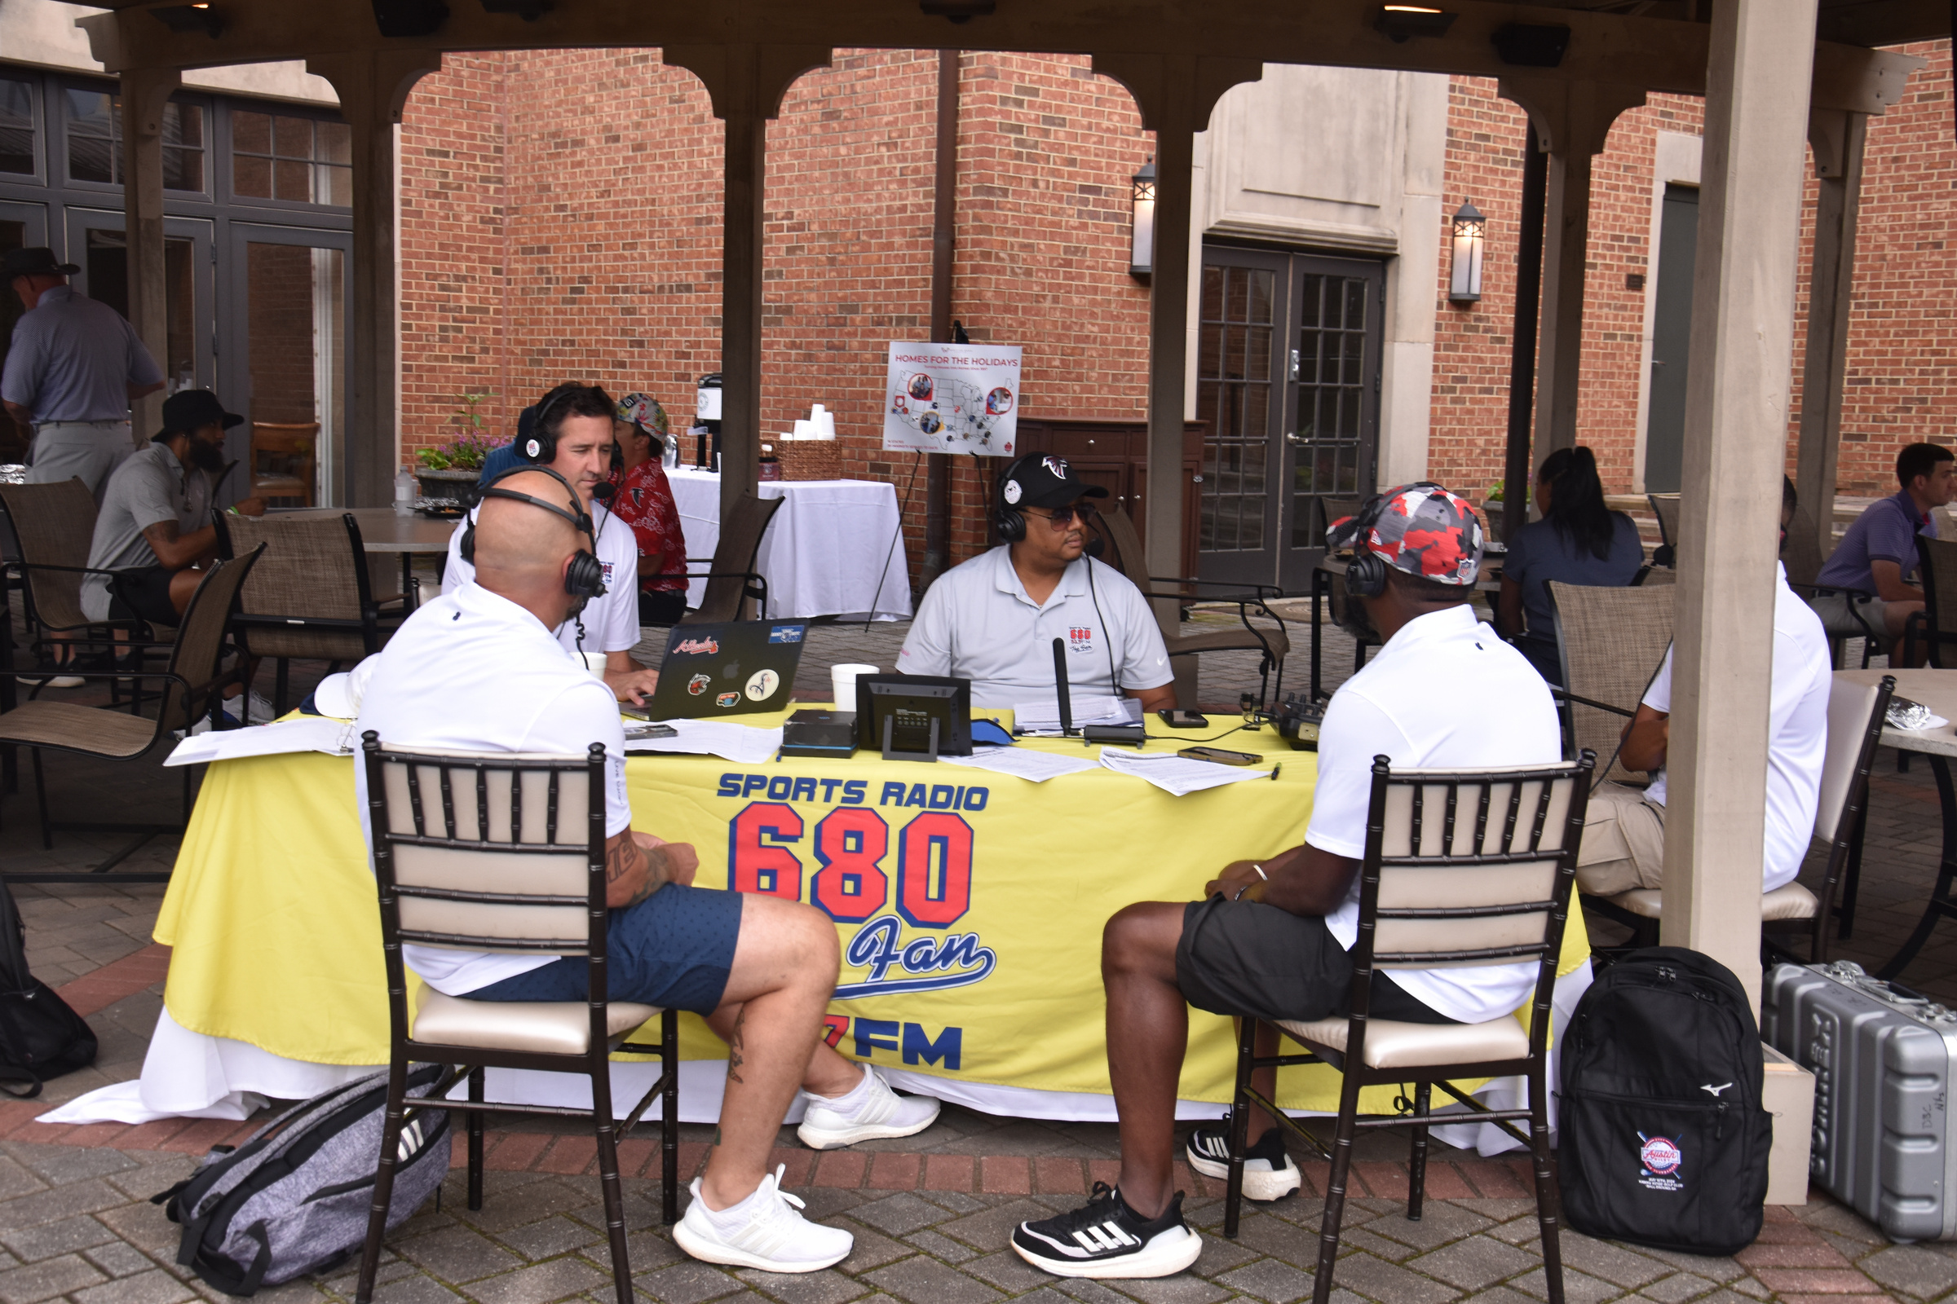
POST GAME RECEPTION SPONSOR - $10,000
• 1 Team at Celebrity Golf Classic including celebrity golfers, appreciation gifts, golf polos
• 6 Tickets to Exclusive Pairings Party Sunday prior to the golf event
• Logo in print on second position of side panel and digitally on PGA Style Electronic display board in all team photos
• Verbal Recognition Shotgun Start
• Third Pick of Celebrity Golfers for Teams
• Opportunity for branded item placement in gift bag for Celebrity Golf Classic
• Logo and brand recognition in select print materials and social media
• Logo on signage at post game reception

Slide 7
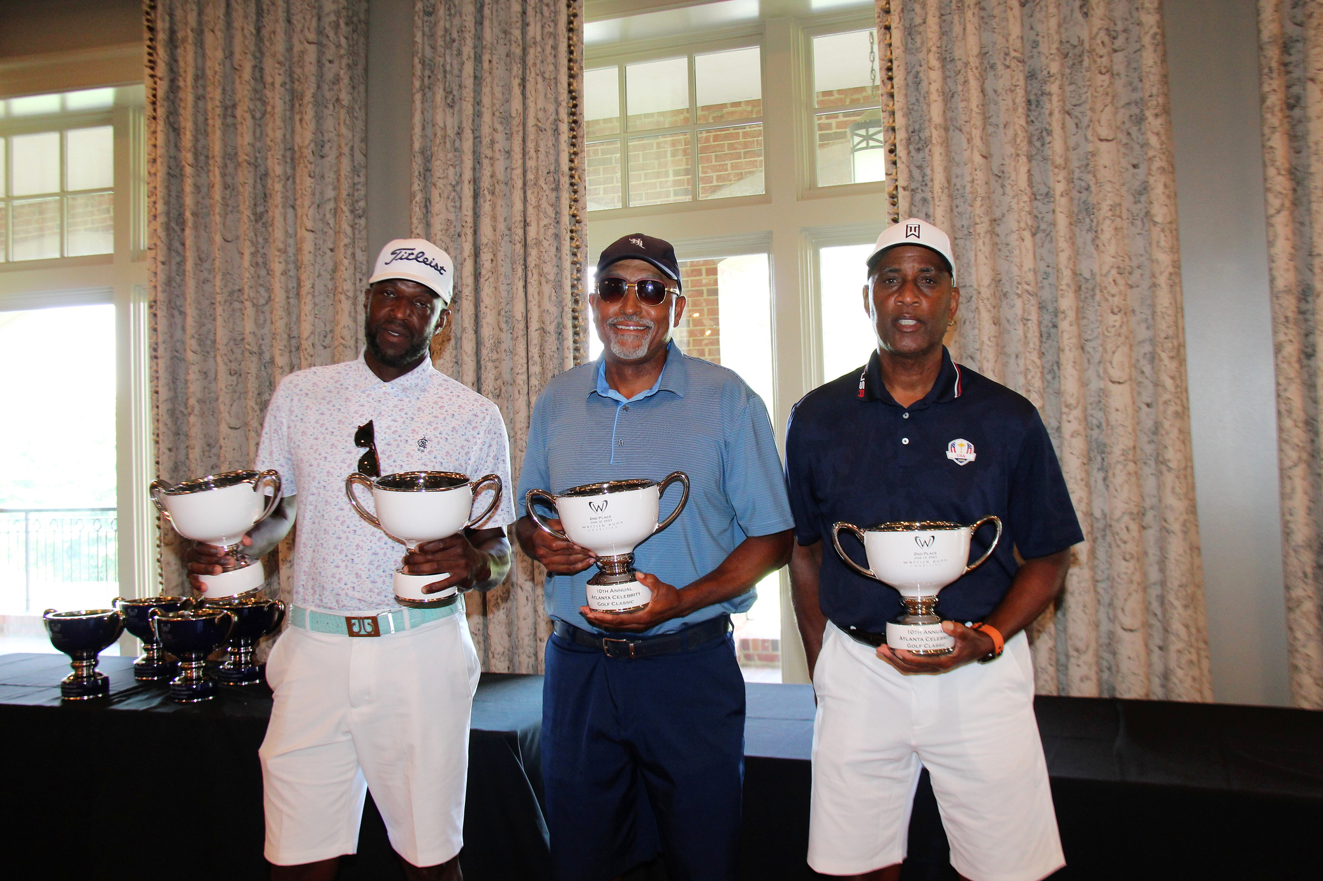
CONTEST SPONSOR - $7,500
• 1 Team at Celebrity Golf Classic including celebrity golfers, appreciation gifts, golf polos
• 4 Tickets to Exclusive Pairings Party Sunday prior to the golf event
• Priority Pick of Celebrity Golfer for Team
• Company recognition at Post Game Reception as contest winners are announced
• Logo digitally on PGA Style Electronic display board
• Logo and brand recognition in select print materials and social media
• 1 hole sign with logo at contest hole

Slide 8
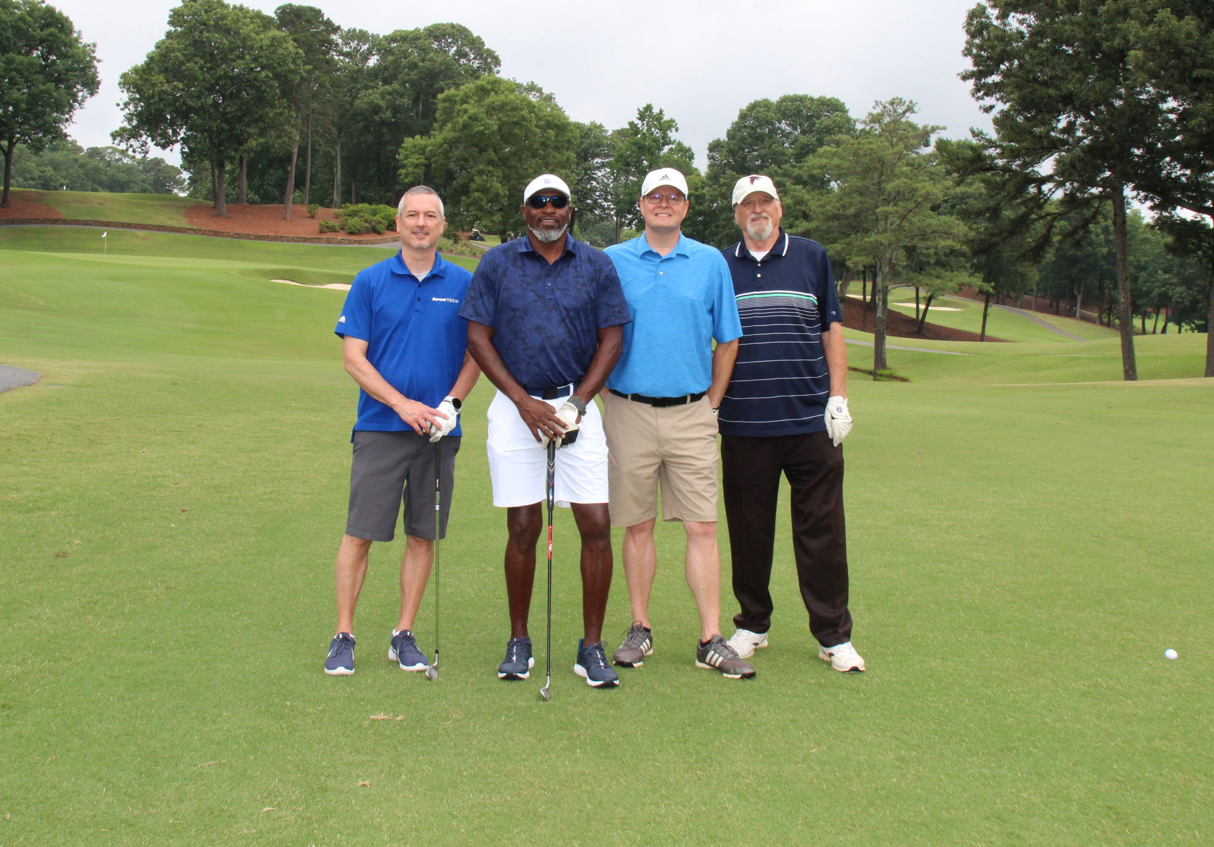
Foursome: $5,000
• 1 Foursome at Celebrity Golf Classic including 3 golfers plus celebrity golfer, appreciation gifts, golf polos
• 4 Tickets to Exclusive Pairings Party Sunday prior to the golf event

Slide 9
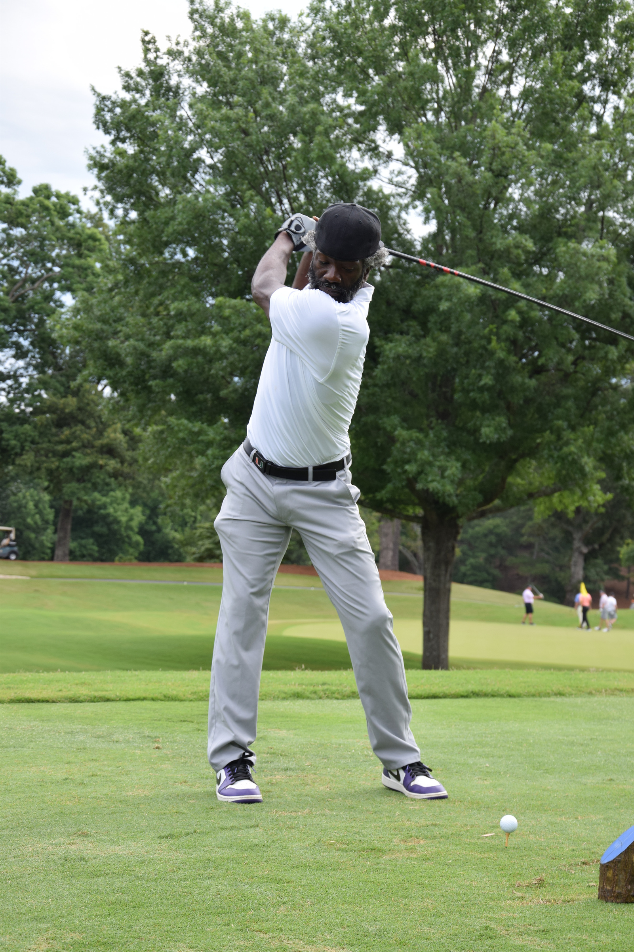
OTHER SPONSORSHIP OPPORTUNITIES
LUNCH SPONSOR : $2,500
• Logo on signage at golfer lunch pickup
• Logo sticker on all golfer lunches
• 1 hole sign with logo on course during play
• Digital recognition on PGA Style Electronic display board
AWARDS SPONSOR: $1,500
• Company recognition at Post Game Reception as contest winners are announced
• 1 hole sign with logo on course during play
• Digital recognition on PGA Style Electronic board
HOLE SPONSOR : $500
• 1 hole sign with logo on course during play
• Digital recognition on PGA Style Electronic board

Slide 10
WHY US?
We believe that by joining forces, we can amplify the positive change we are striving to achieve. We are humbly requesting your support, whether through a sponsorship package, financial contributions, or in-kind donations. Your partnership can help us reach new heights and create a more significant and lasting impact on more single parents, individuals and families. Not just for this generation but for generations to come.
I would welcome the opportunity to discuss in more detail how you or your company can become an integral part of our mission and vision. Your support will not only benefit Warrick Dunn Charities but will also align your corporation with a cause that reflects your commitment to making the world a better place.
Please feel free to contact me at events@wdc.org or (470) 585- 1648 at your convenience to arrange a meeting or discuss sponsorship opportunities. I am eager to explore how we can work together to create a brighter and more compassionate future.
To purchase click here: Sponsorships and Foursomes

